Slide 1
AP CSP 4.2
Fault Tolerance
Zeynep Bade Başlıgil

Slide 2
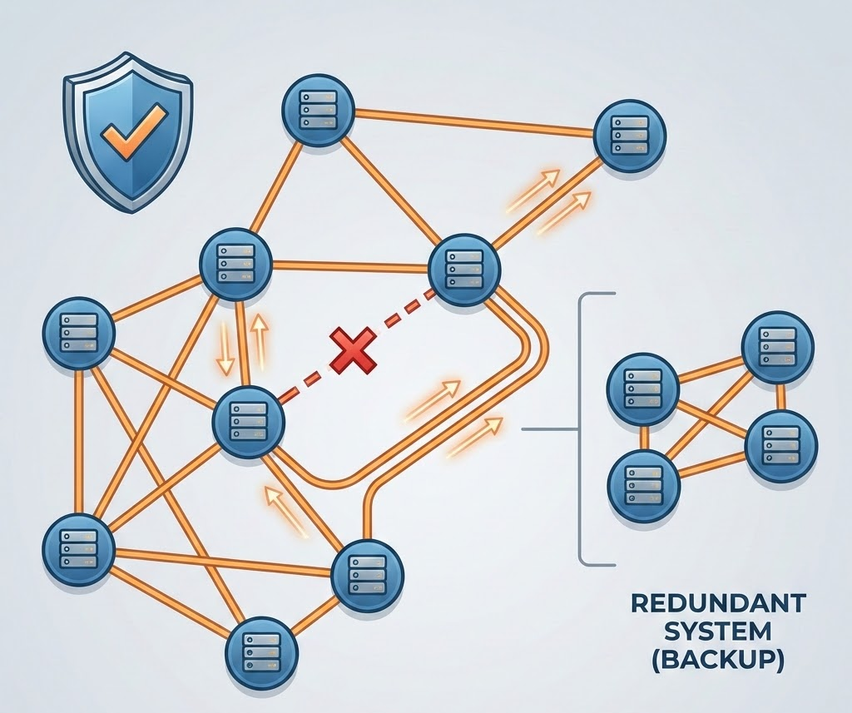
What is Fault Tolerance? - General Overview
Fault Tolerance is a system's ability to continue operating uninterrupted despite the failure of one or more of its components.
Although in almost all cases redundancy is necessary for fault tolerance it can take up a lot of additional resources thus turning into a setback.
Learning Objective:
In this part of the Big Idea you should be able to explain how a system/network is fault tolerant
Redundancy can be achieved by having a large number of pathways between connections in networks.
You can add more and more devices to your network as it makes the network stronger!!
For a system or network to be fault tolerant ,aka be able to function even if some components fail, that system -or network- has to be redundant.
Notes:
Redundant / redundancy: the inclusion of extra components which are not strictly necessary to functioning, in case of failure in other components.

Slide 3

Notes:
AP CSP düzeyinde, internet paket anahtarlama (packet switching) kullanır; yani veriler küçük paketlere bölünür ve ağın bir kısmı çalışmazsa farklı yollardan hedefe ulaşabilir. Ayrıca yedeklilik (redundancy) ve Border Gateway Protocol gibi yönlendirme protokolleri sayesinde veri otomatik olarak alternatif yollara yönlendirilir ve iletişim kesilmez.
The internet is designed to be fault tolerant, but there have been times when failures still caused major disruptions. For example, during the Facebook outage of 2021, a misconfiguration in routing (related to systems like the Border Gateway Protocol) took down Facebook, Instagram, and WhatsApp worldwide for hours, showing that parts of the internet can still fail despite built-in redundancy.

Slide 4
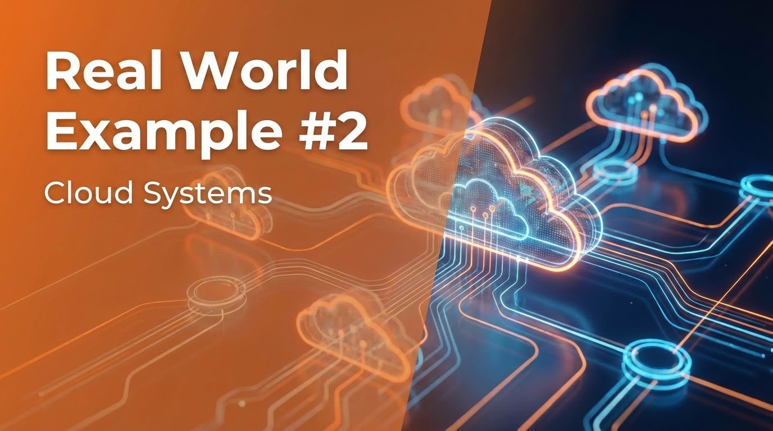

Slide 5
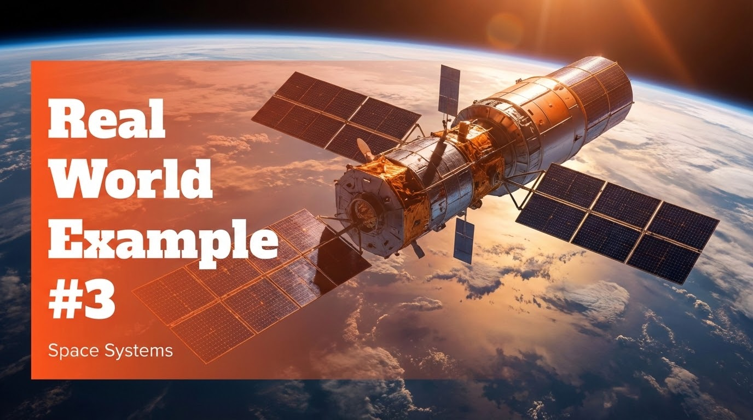
Real World Example #3
Space Systems
Notes:
Space systems are machines like satellites or spacecraft that operate in space, far from Earth. They are fault tolerant because they have backup parts and systems in case something breaks, since repairs are usually impossible. This way, even if one component fails, the spacecraft can keep working and complete its mission safely.

Slide 6
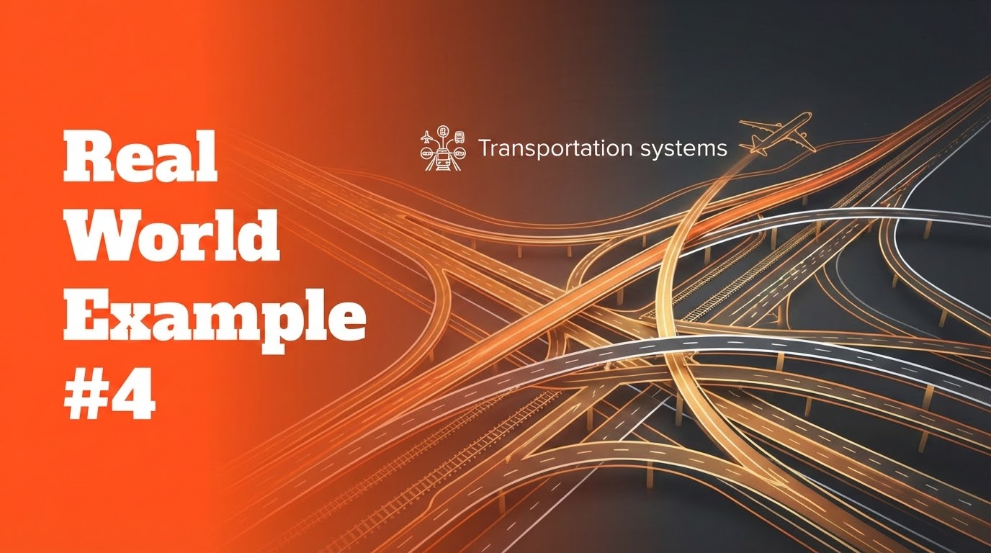
Real World Example #4
Transportation systems
Notes:
Transportation systems are fault tolerant because they have backup mechanisms and safety rules that keep operations running even if part of the system fails. For example, trains stop automatically if signals fail, and roads or air traffic can be rerouted to avoid problems.

Slide 7
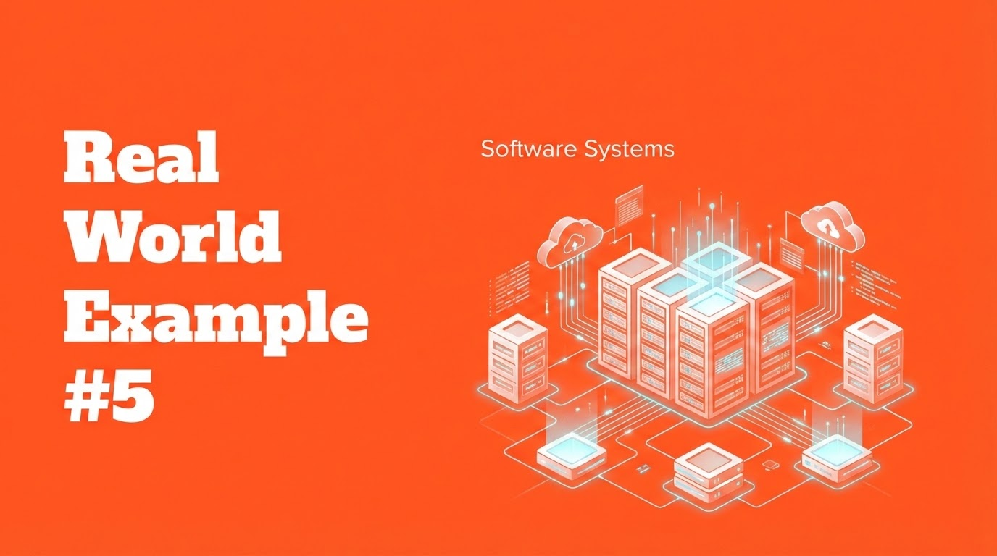
Real World Example #5
Software Systems
Notes:
Software systems are fault tolerant because they can detect failures and automatically restart or switch tasks to working components. This ensures the application keeps running smoothly even if part of the system crashes.

Slide 8
What do they all have in common?
Redundancy
Failover mechanisms
Notes:
As you can see!

Slide 9
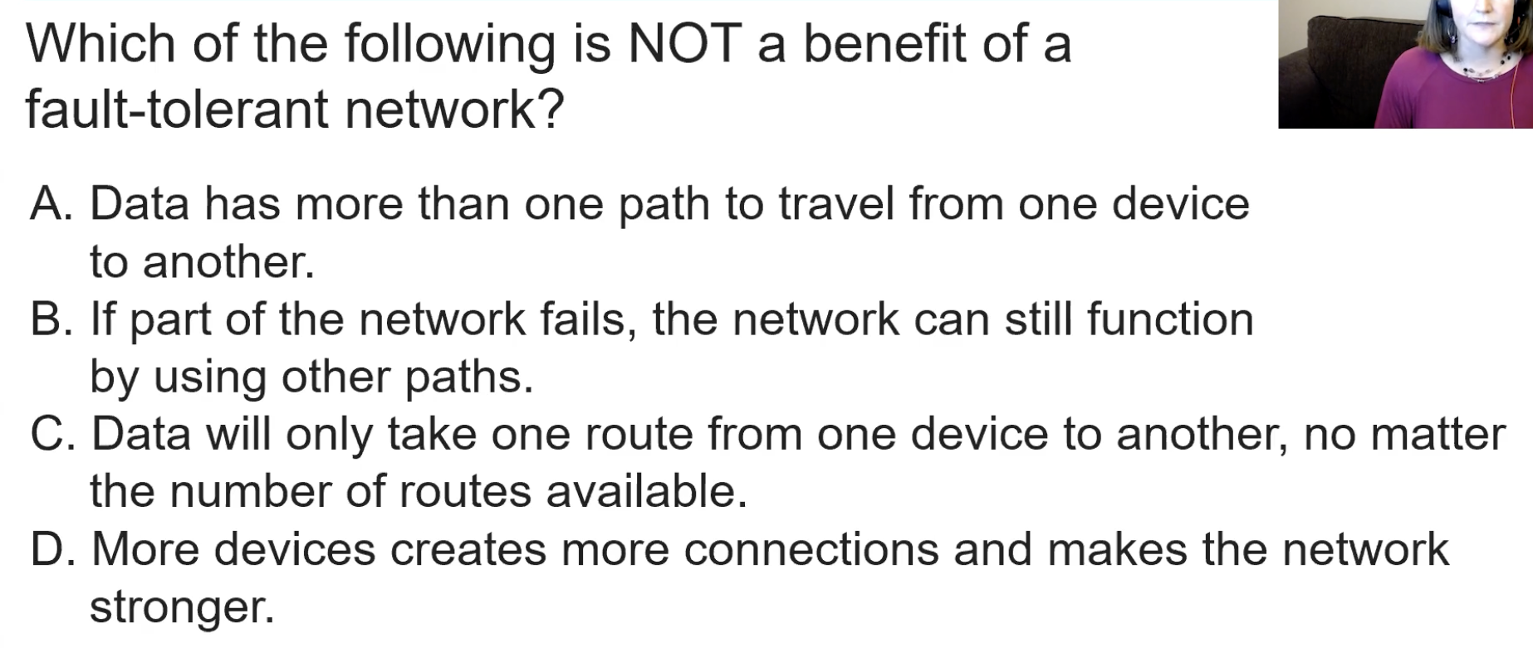
Example Question #1

Slide 10
Solution

Slide 11
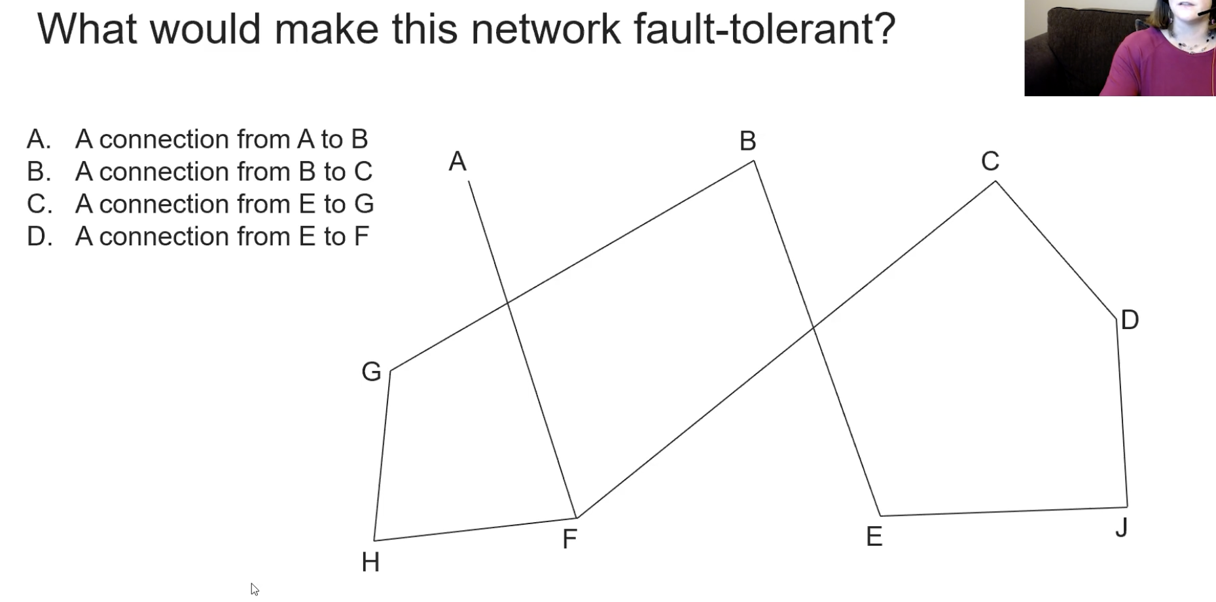
Example Question #2:

Slide 12
Solution
Tip: in such questions count the number of connections each points have and add a new connection to the point with the least amount of connections!

Slide 13
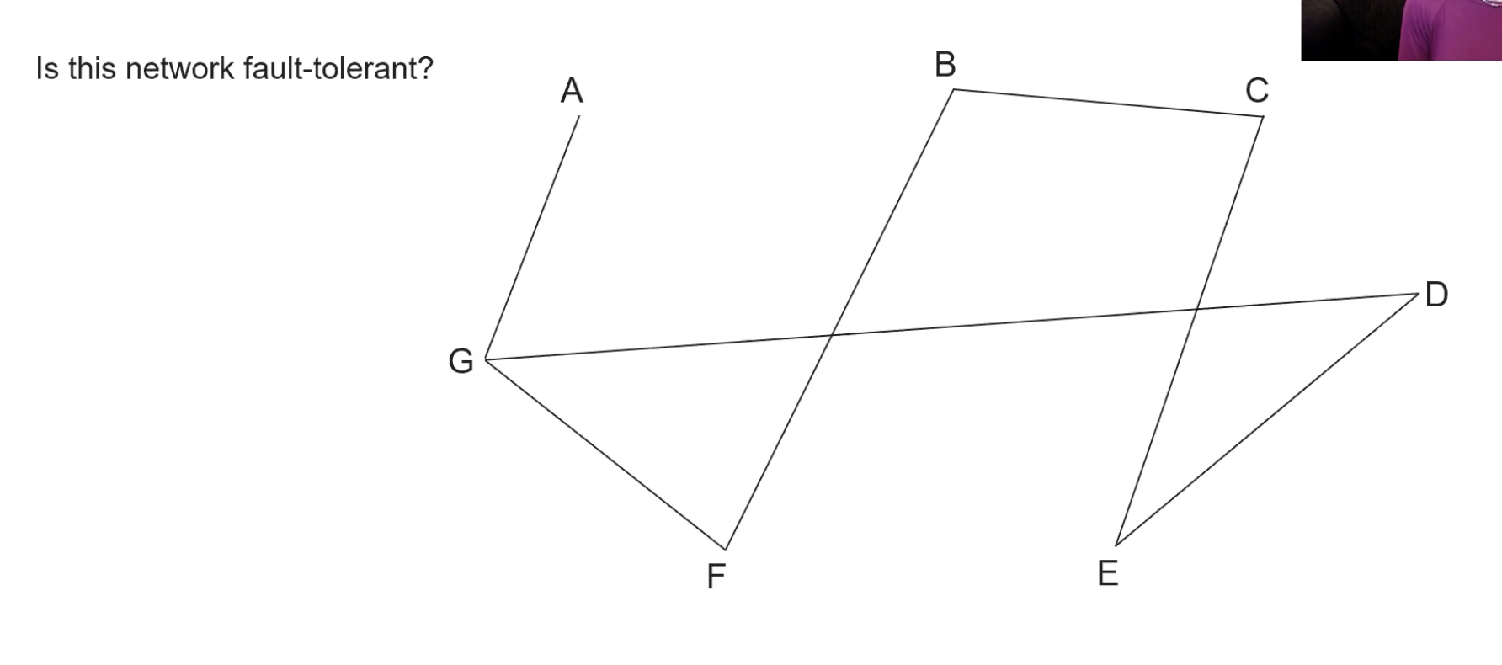
Example Question #3:

Slide 14
Solution
No! It is not because if the connection between points A and G shut down there will be no connection from A to any other points causing failures in the system. If there was any other connections from point A to any other points than the network would be more fault tolerant.

Slide 15
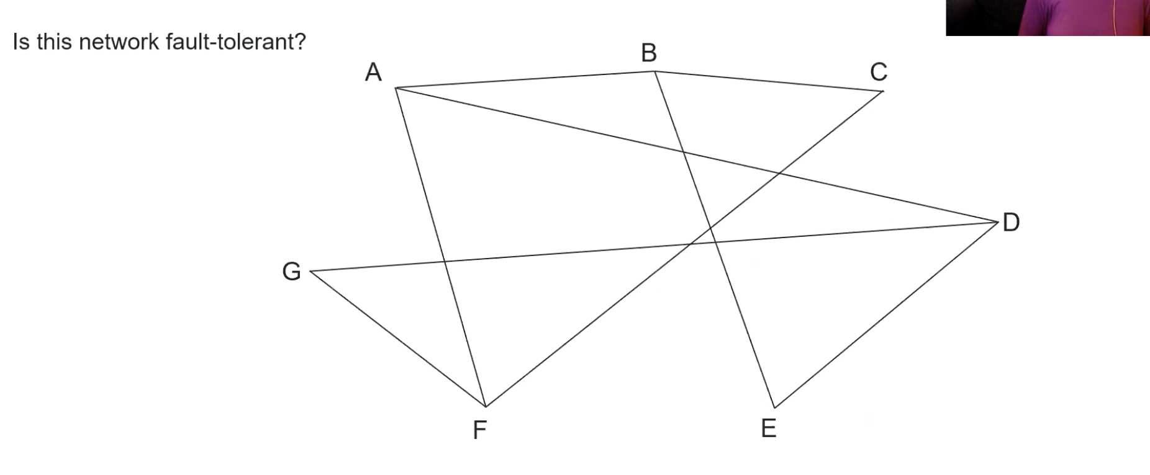
Example Question #4:

Slide 16
Solution
Yes it is!! All points have at least two connections so the network is able to keep on working even if one connection shuts down.

Slide 17

Example Question #5:

Slide 18
Solution
No! It is not because if the connection between points F and C shut down there will be no connection from F to any other points causing failures in the system. If there was any other connections from point F to any other points than the network would be more fault tolerant.

